Slide 1
Bookilicious
A world of unique portable magic

Slide 2
What we are going to explain today!
Introduction
Technologies used
Work division
Work description
Challenges faced
Qs/Ans
A brief description of the project.
What technologies and tools are used in the project
How we divided the tasks
Everyone describing their work.
All the challenges and troubles faced in the project.
Qs and answers from the audience.

Slide 3
Introduction
The software is named “Online Bookstore”. Online Bookstore is an application where the customer can buy books online. Customers can search for a book by title, ISBN, or other criteria, add books to their shopping carts, and then purchase the book. The user can log in using his or her previously existing account, or new customers can easily create an account. They should include information such as their name, phone number, and email address.
Database will be used to store the data of users and books.The main objective of the system is to provide the user with ease of access to buy/sell books online.

Slide 4
Technologies used
01
02
03
04
Django
CSS , HTML
Backend
Frontend
MTSQL
Bootstrap, JQuery
Database
Frontend

Slide 5
Work division
Amna Ahmad
Misbah Noor Awan
Setup of database
Normalization
Integration
Triggers and user privileges
Database setup
views
UI UX design
integration
M-Ali Usman
Database population
ERD diagram
Database setup
Stored procedure

Slide 6
01
Search engine
SEO applied

Slide 7
Search engine Optimization
Author
Book name
Categories
Search through author
Isearch through book name
Search through categories

Slide 8
01
Privaliges and roles
Types of users in our project!

Slide 9
Admin user
Admin user can change the following :
Add a new book
View stats
View order processed
Rating wise books

Slide 10
Customer user
Admin user can change the following :
Search a book
Add in cart
Search via categories
Proceed the order
View order
Review books
View profile

Slide 11
01
ERD
ERD diagram of the project

Slide 12
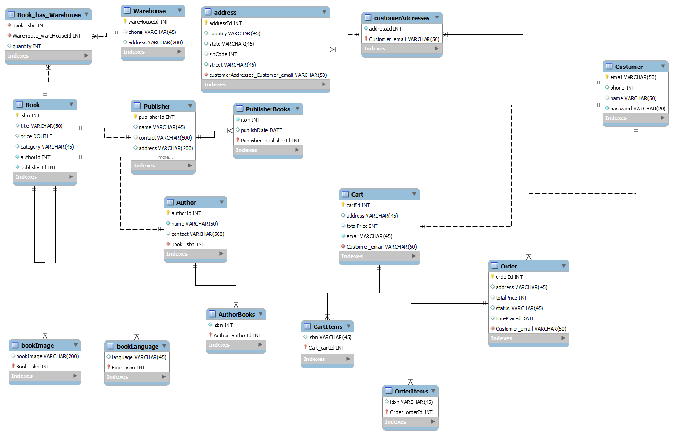
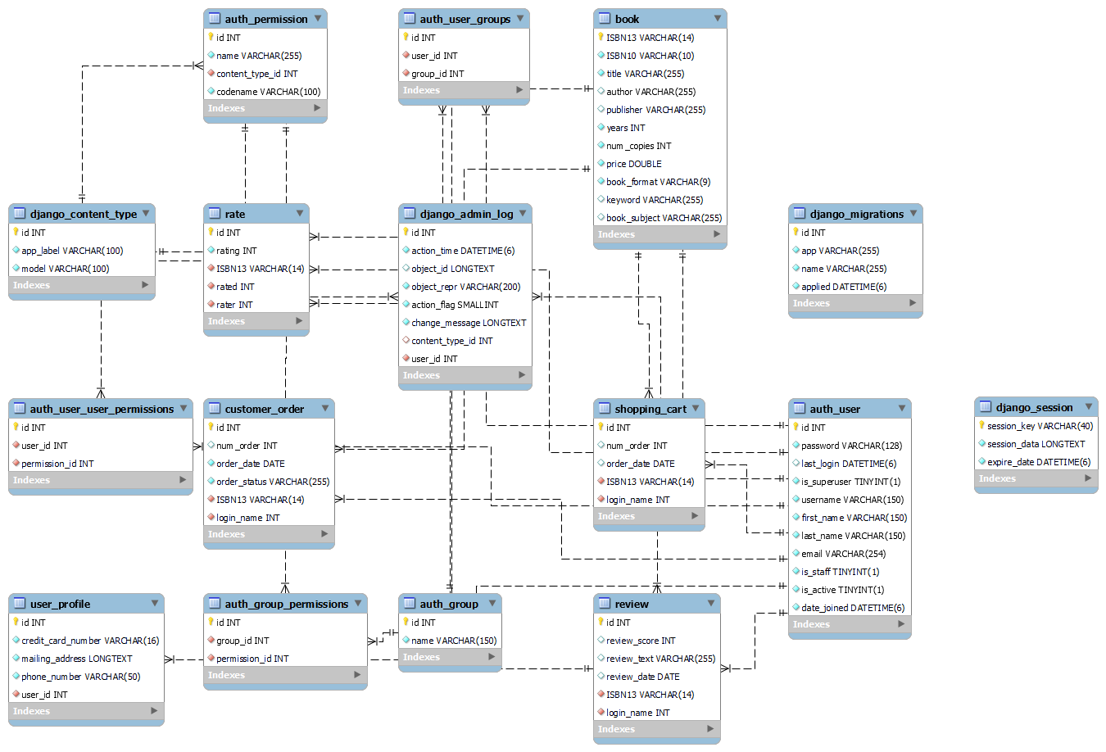

Slide 13
01
Database
Database setup and population

Slide 14
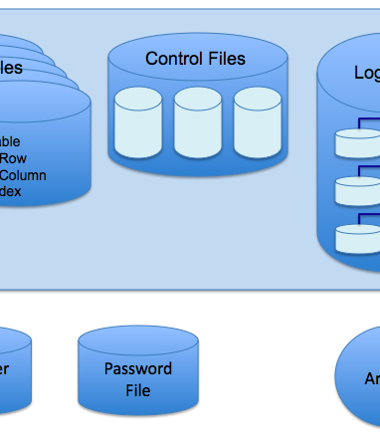
Database setup
I used MYSQL to create the schema “Django_bookstore”.
This schema has 17 tables. Every related table is connected to its parent table.
6 main tables and further normalization , also some were caused by django.

Slide 15
01
Attributes
Attributes of the project

Slide 16
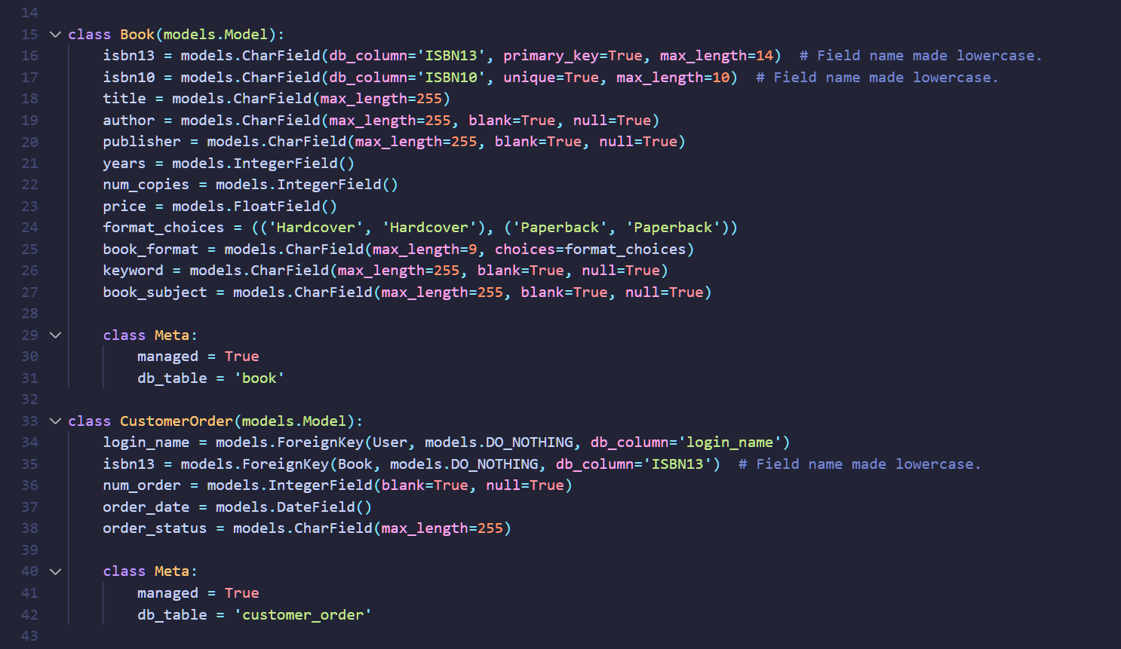
Attributes

Slide 17
01
Database population
Data entry

Slide 18
Database population
Database was populated using the frontend .
Testing was done through the admin and user portals both
Order details, new users, new books all attributes are updated.

Slide 19
01
Views
Data entry

Slide 20
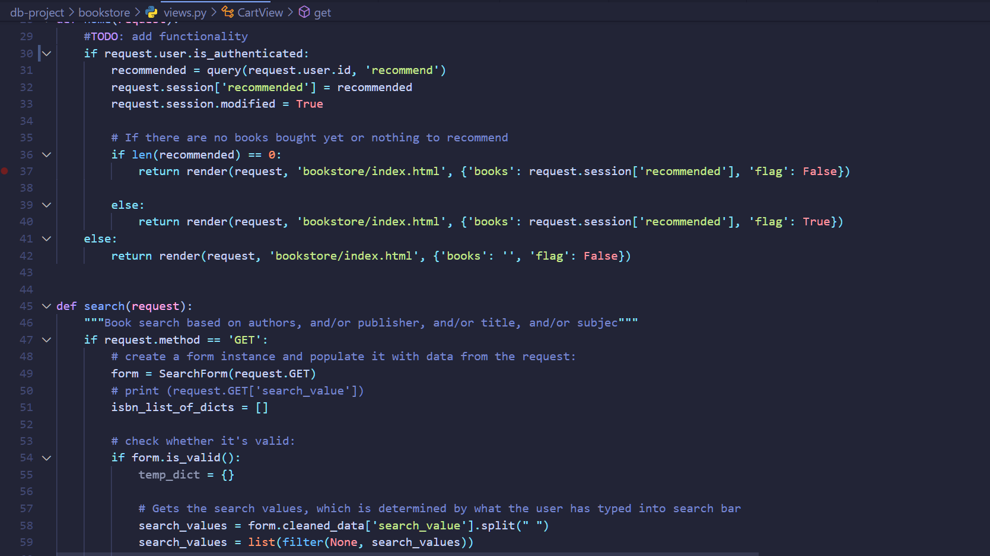
Views

Slide 21
01
Stored procedures
& triggers
How we integrated the project

Slide 22
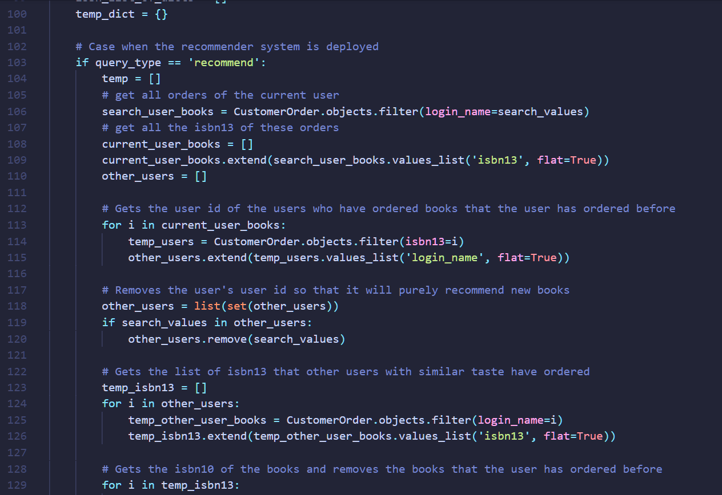
Triggers

Slide 23
Challenges Faced
Normalization was a difficult task as there was high chance of redundancy
Search engine was difficult to implement

Slide 24

Demo

Slide 25
Q’s Answers

Slide 26
Thank you!

